Slide 1


Presentation of Final year project on “Virtual Telepresence Robot”
Guided By-
Ms. K V Shanthala
Presented By –
Kiran A – 1JS19CS076
NikhilRaju – 1JS19CS102
Mudasir Ahamed – 1JS19CS091
Prithviraj Patil - 1JS19CS125

Slide 2
Abstract
The primary goal of the project is to create a robot utilizing a Raspberry Pi for virtual telepresence. The smartphone's project reads the accelerometer and magnetometer data of the user's head movement, such as a right or left turn. This information is transmitted through Wi-Fi to the modem and the Raspberry Pi board, which then use these values as inputs to the servo motors. For object detection, this system makes use of image processing technology.

Slide 3
Introduction
Virtual telepresence refers to the use of technology to create a sense of presence and enable remote interaction with people or environments. It allows individuals to virtually be in a different location and engage in real-time communication and collaboration as if they were physically present.
Virtual telepresence enables remote collaboration, virtual meeting, remote learning, remote medical consultations and immersive experiences.
By utilizing virtual telepresence technologies, individuals can transcend the limitations of physical distance and engage in meaningful interactions and experiences with others, regardless of their geographical location.

Slide 4
Objectives of virtual telepresence robot
To design a robot for virtual telepresence.
Using Raspberry pi to achieve the task.
To send data to the modem using Wi-Fi.
This robot can send the live visuals along with obstacle detection to the VR headset.

Slide 5
Hardware Requirements
Raspberry Pi
Raspberry Pi Camera Module
Bluetooth Module HC - 05
Servo motors
VR Headset
Voltage Regulator
l293d Motor Driver
DC motors
Bread board
SD Card
Batteries 12V 2A
Charger

Slide 6
Software Requirements
Raspberry Pi Operating System
Bluetooth HC – 05 Application
Dual Browser Application
Network Analyzer Application
Wireless IMU Application
Python

Slide 7
Raspberry Pi
Raspberry Pi is a series of small, single-board computers developed by the Raspberry Pi Foundation. These compact computers are designed to be affordable and accessible, with the goal of promoting education and providing a platform for experimenting with computer programming and electronics.
Specifications:
Processor: Broadcom BCM2837B0, Cortex-A53 64-bit SoC @ 1.4 GHz
Memory: 512MB LPDDR2 SDRA
SD card support: Micro SD format for loading operating system and data storage
Input power: 5 V/2.5 A DC via micro USB connector 5 V DC via GPIO header

Slide 8
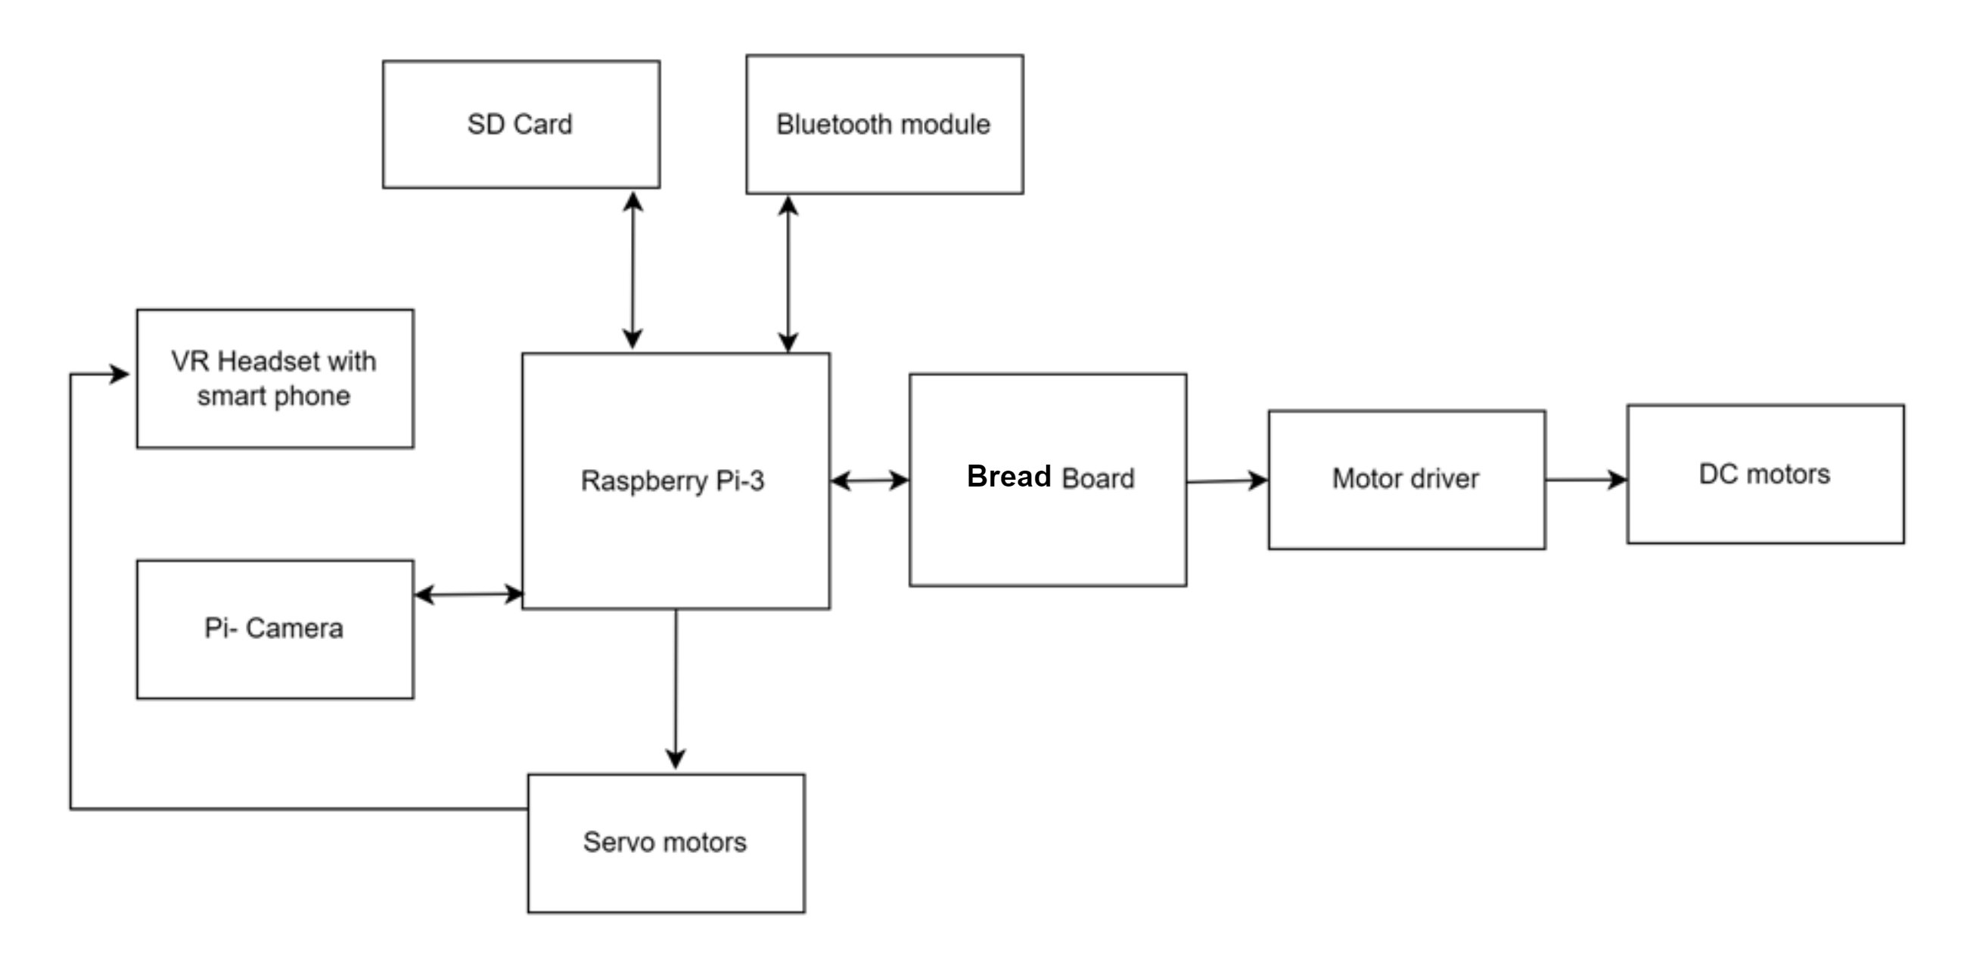
Architecture

Slide 9
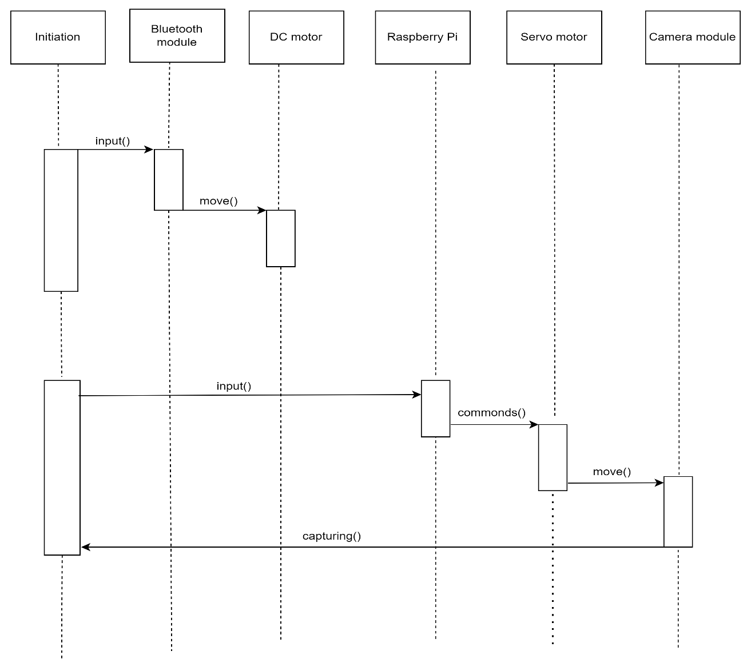
Sequence Diagram

Slide 10
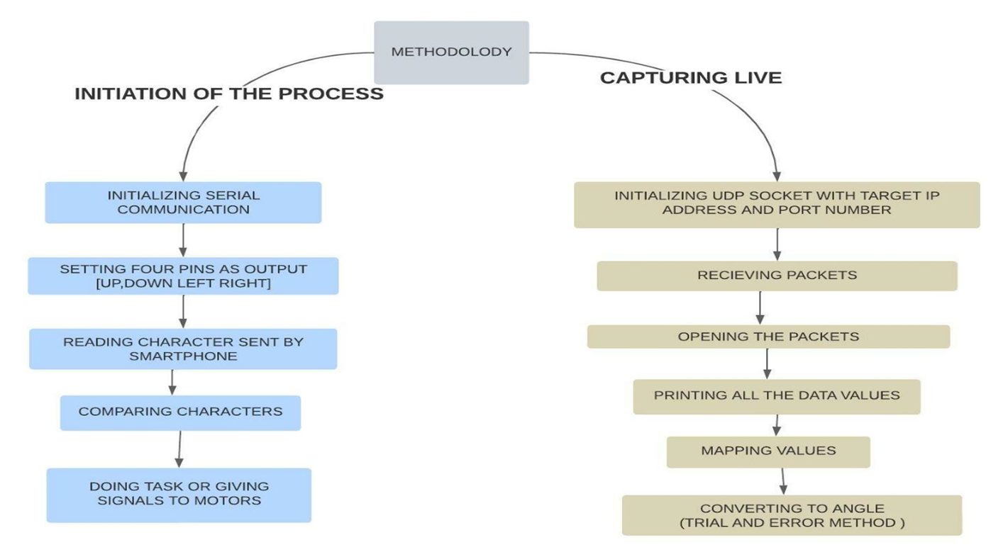
Methodology

Slide 11
Working of virtual telepresence robot
Two servo motors are used to move the camera—one for the vertical movement and the other for the horizontal movement. So when you turn our head along with VR headset to the right side, the Raspberry Pi camera will also turn to the right direction and the image of the object along with video is sent to the user mobile via wi-fi.
The smartphone also provides input to the l293d moto driver for the purpose of navigation or movement of the robot. The motor driver IC and geared motors are connected at the end of the navigation circuit. The commands to run the robot can be sent via Bluetooth from the smartphone. In this example, Bluetooth is used.

Slide 12
Applications
The robot can be used in fire and rescue operations.
In the Medical case, at times when the doctor is not able to go on rounds, the robot can be used to check the state of the patient.
As the robot capture the visuals and classify the objects so it can be used in archeology survey.
The robot gives the real time visual experience, it is helpful for users to view real estate virtually.

Slide 13
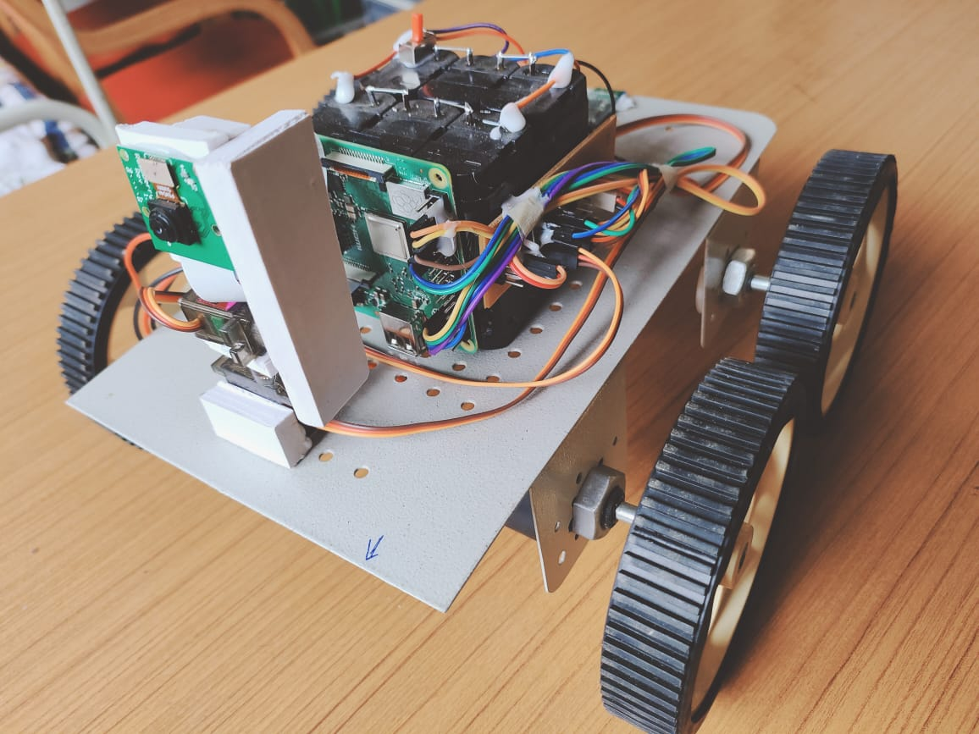
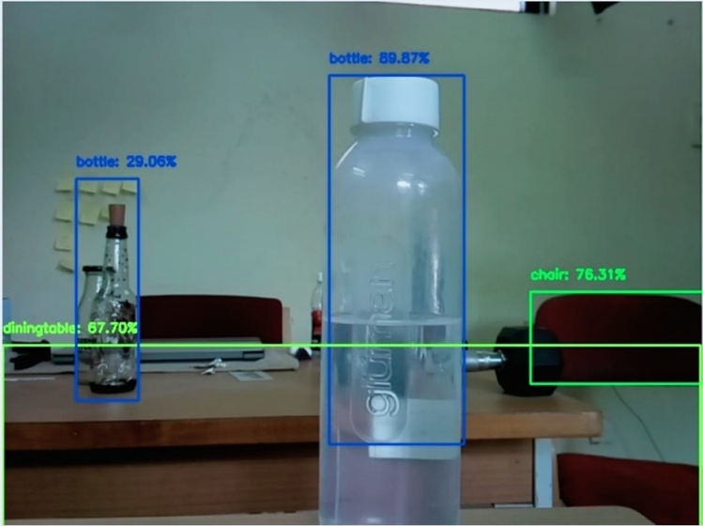
Result
After assembling the hardware and installing and running the software we successfully demonstrated that the telepresence robot provides us the video streaming in the direction of our requirement.

Slide 14
Conclusion
Integrating features of all the hardware components used have been developed in it. Presence of every module has been reasoned out and placed carefully, thus contributing to the best working of the unit. Secondly, using highly advanced IC’s with the help of growing technology, the project has been successfully implemented. Thus the project has been successfully designed and tested.

Slide 15
THANK YOU

